Slide 1
Computer and Systems Engineering
Department,
Alexandria University
“Hand Wave” : American Sign Language Recognition System
Mohamed Metwalli Noureldin
Aya Khames Khairy

Slide 2
Content
Introduction
Goal of project
Workflow
Data Collection
Challenges and Decisions
Plans for Next Semester

Slide 3

1. Introduction
Communication between humans is a form of life, as we do this every single day and we may need to communicate with people who don’t speak the same language as ours, but despite the many languages, communication has become easier because of translators.
Now, what about the deaf and dumb people, couldn't it be easier to communicate with them..?

Slide 4
2. Goal Of Project
We are going to build a software application as a real time translator for the American sign language (ASL) using the
CNN-based detection models with the technique of transfer learning.
This translator is going to recognize the ASL letters including the
dynamic ones, digits and some agreed on words, Not sentences.

Slide 5

Why The ASL ..!
We decided to use the American sign language as :
1. The huge amount of data available.
2. It’s the most widely used sign language.

Slide 6
3. Workflow
Traditional CNN
Faster R-CNN
YOLO
SSD

Slide 7
3.1. Traditional CNN
We faced problems with this approach especially that we intend to build a real-time application:
Hand detection in the real-time frame and cropping.
Slow detection in the real time (1FPS without efficient hand cropping).
No data available for the ASL words, which is needed with huge amount for the training.
So, we claimed that it’s not widely used in the real-time applications.
Think about transfer learning & object detection models.

Slide 8
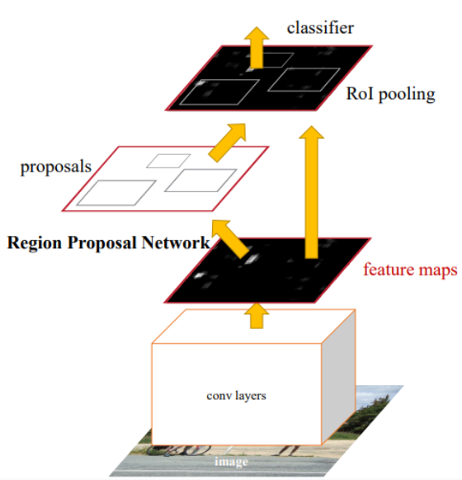
3.2. Faster R-CNN Model
Two-stage Network, one stage for region proposal and the other one is for detection.
Faster than the traditional CNN
Traditional CNN 1FPS
Faster R-CNN 7FPS

Slide 9
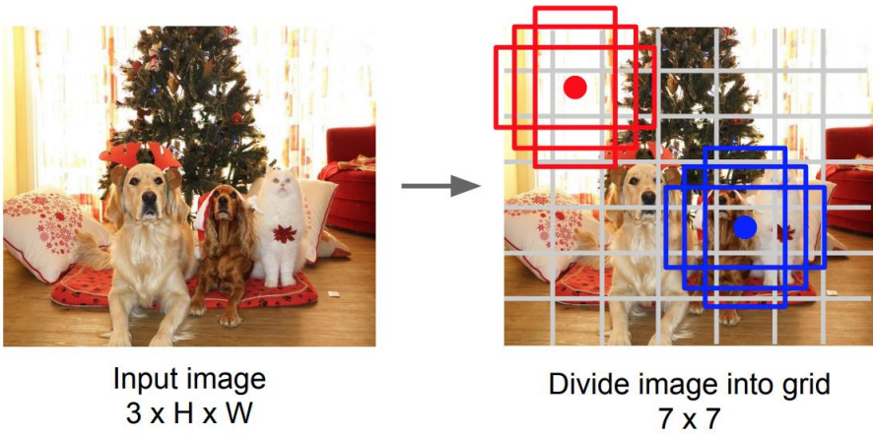
3.3. YOLO Model
Single-stage Network, depends on the anchor boxes instead of the stage of the region proposal.
Faster than Faster R-CNN

Slide 10
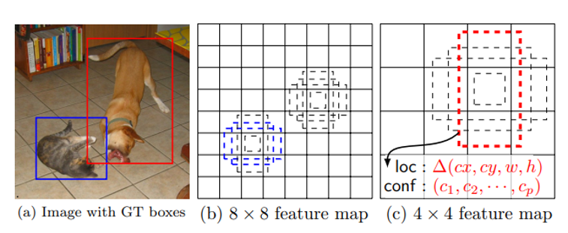
3.4. SSD Model
Single-stage Network, depends on the default boxes instead of the stage of the region proposal, uses multi-scale feature maps.
Faster than YOLO

Slide 11
Models Speeds
The speed is measured by the number of frames being detected per second (FPS).
Faster R-CNN
YOLO
SSD

Slide 12
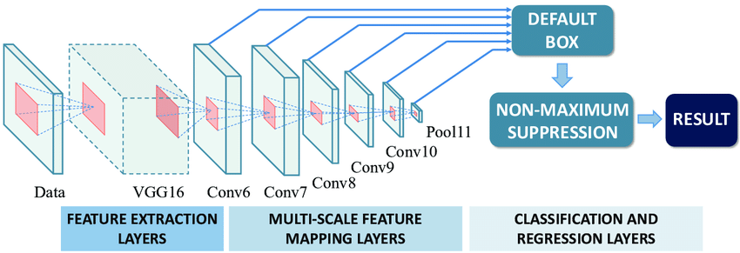
Proposed SSD Model Architecture

Slide 13
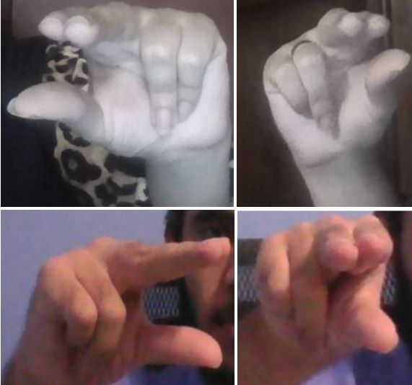
4. Data Collection
1
Not only the hands
This is a sample of the collected data for the traditional CNN training, as it’s cropped to get only the hand. We tried to make variety in the lighting conditions, skin tones and the background to make the model as robust as possible.
But we need to collect the data in a new way to fit with the SSD architecture and add the ground truth to it.
2
Data Augmentation
3
Variety lightning and background
100 images per class
~40 classes → ~4k images

Slide 14
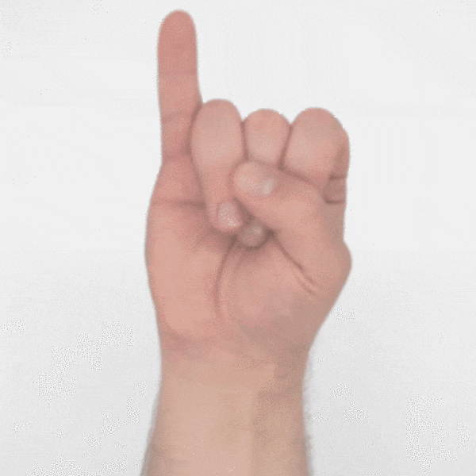
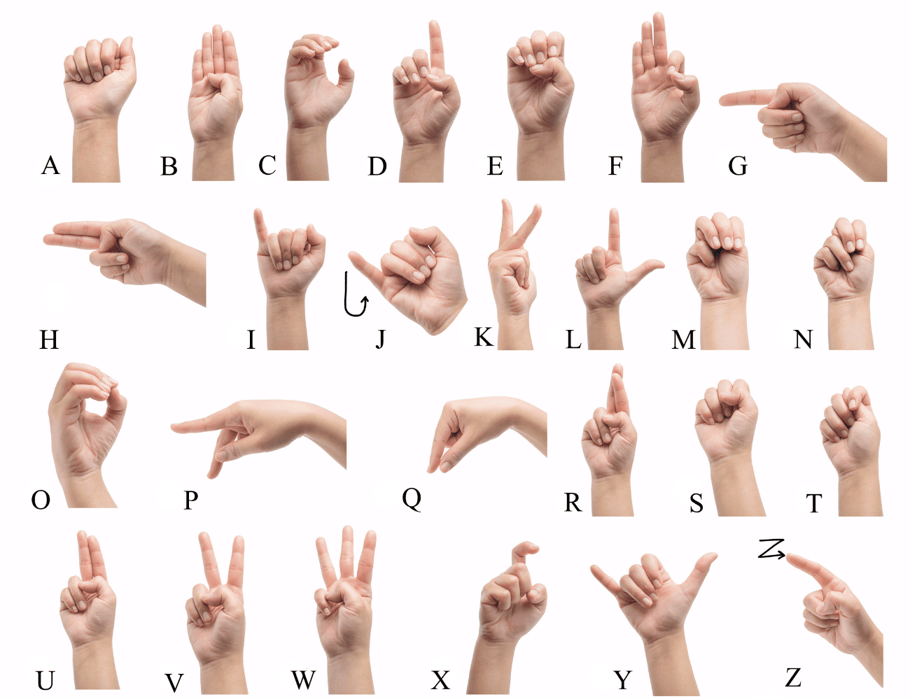
5. Challenges & Decisions
Dynamic Letters
Classes Similarities
(J & Z) were excluded in all the implementations we’ve seen
Same object with different poses
we will try to deal with it by taking a frame for every possible pose of the motion of the letters which will increase the accuracy.
we are going to try training only one model over the whole data (letters, numbers and some words) and try to get good detection results, if the results weren’t good, we are going to train three models one for the letters, one for the digits and one for the words to reduce the similarities by reducing the number of classes that the model needs to distinguish between.

Slide 15
6. Plans for next semester

Slide 16
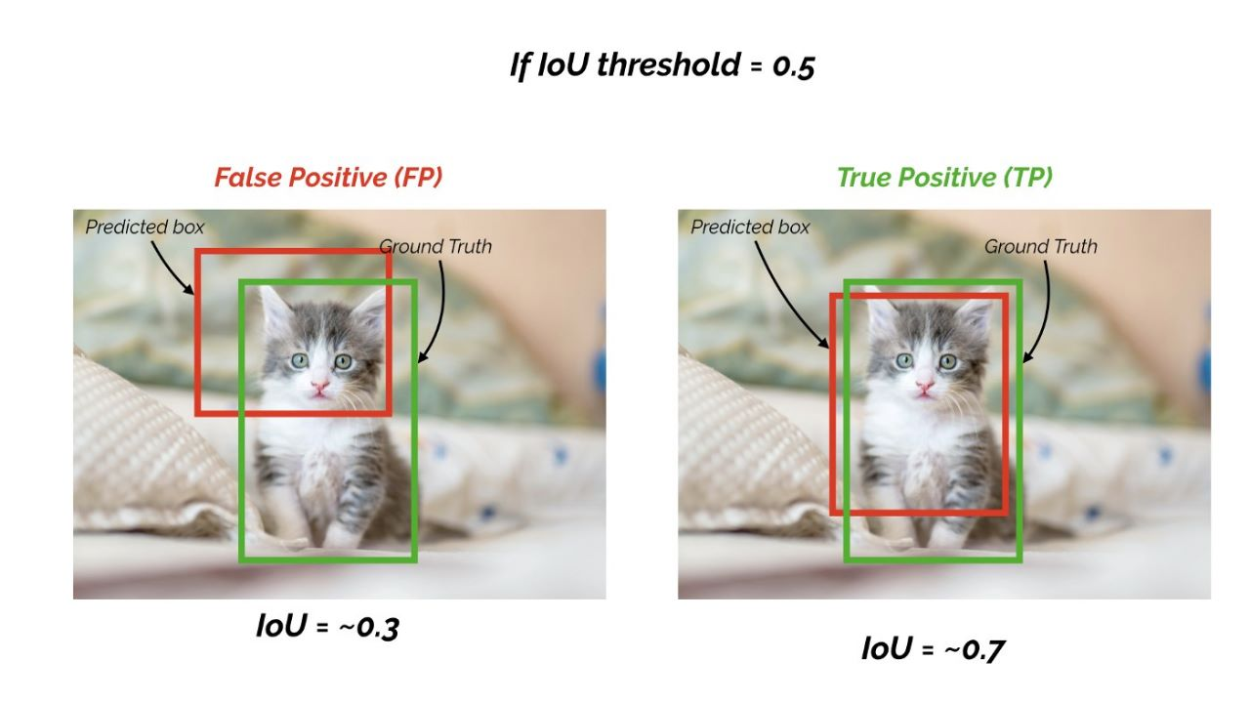
1. Recollecting New Data
We are going to recollect the data to be suitable for the SSD architecture.
2. Model Training
Use one of the SSD versions by applying transfer learning on the collected data for the ~40 classes.
3. Model Testing
Test the model over some data from the collected one but not trained on, and on the real-time.
Use the intersection over union (IOU), and mean average precision (mAP) metrics for evaluation.

Slide 17






Web Application
• Flask framework.
• Offline Python IDE like “Jupyter NoteBook”.
• Online Python IDE like Google Colab if needed due to GPU requiring.
• HTML, CSS, JavaScript.

Slide 18
Thank You!
Any questions?

